Slide 1
Volatile Oils
Dr. Marriam Zaka
Lecturer
Institute of Pharmacy,
Faculty of Pharmaceutical and Allied Health Sciences, LCWU, Lahore.

Slide 2
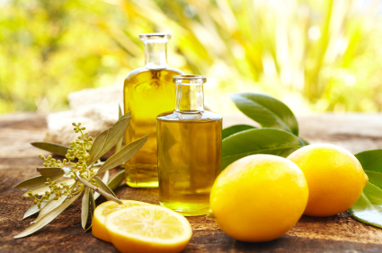
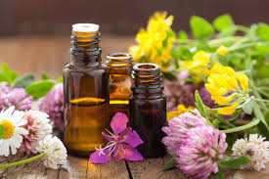
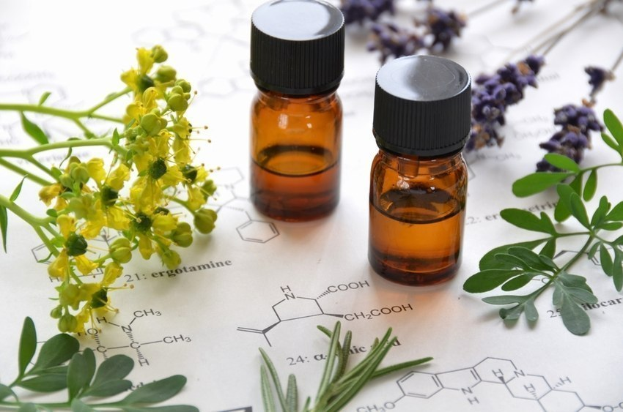

Slide 3
Introduction
Volatile oils are odorous volatile principles found in various plant parts, evaporate when exposed to air at ordinary temperature, and hence known as volatile or ethereal oils.
These represent essence of active constituents of the plants and hence also known as essential oils.

Slide 4
As the name indicate these oils have particular smell or odor and are volatile in nature. They are colorless when fresh but darker in color after prolonged storage due to oxidation, so they should be placed in dry place.

Slide 5
Chemically volatile are the mixture of eleoptene and stearoptene.
Volatile oil = eleoptenes + stearoptenes
They are generally a mixture of hydrocarbons and oxygenated hydrocarbons derived from these hydrocarbons.

Slide 6
The hydrocarbons are generally terpenes derivatives formed by a acetate mavalonic pathway and often a liquid portion known as eleoptenes.
The oxygenated hydration portion which is derived from schikimic acid pathway and often a solid portion known as stearoptenes.
The odor and taste of volatile oil is due to stearoptenes which is usually soluble in water.

Slide 7
Mevalonic acid
Shikimic acid

Slide 8
Properties
.
These are soluble in alcohol and other organic solvents,
practically insoluble in water, lighter than water (Clove oil
heavier), possess characteristic odor and most of them are
optically active.
Volatile oils are colorless liquids.
Unlike fixed oils, volatile oils neither leave permanent
grease spot on filter paper nor saponified with alkalis.
The volatile oils dissolve many of the proximate principles
of plant and animal tissues, such as the fixed oils and fats,
resins, camphor, and many of the alkaloids when in the free
state.

Slide 9
Significance of Volatile oils
Volatile oils have great significance in human life but the exact value of volatile oils is not known in plant life. They are produced as a result of metabolism.
However it is said to be:
1. Insect attractant
They may serve as insect attractant thus helping in cross fertilization of the flowers.
2. Insect repellant
Due to their specific odor thus preventing the destruction of
flowers.

Slide 10
There are three main purposes of volatile oils in Human life:
(i) They are used therapeutically.
(ii)They are used for flavouring.
(iii)They are used for perfumes and cosmetics.
Therapeutically they are used as
Carminative
Irritant
Local anaesthetic
Antiseptic
Expectorant
Antibacterial, antifungal, antihelmenthics etc

Slide 11
Methods of obtaining volatile oils
There are following methods used:
1. Distillation
2. Expression
3. Enzymatic hydrolysis
4. Solvent extraction
5. Enfluerage method
6. Destructive distillation

Slide 12
1.Distillation of volatile oils
A: Water distillation
This method is applied to those plants which are not injured by boiling.
E.g Terpentine oil
The crude drugs are introduced in the distillation chamber along with water and subjected to heat until the oil is condensed in the receiver or condensing chamber.
Terpentine oil is consisting entirely of terpenes which is not affected by heat.

Slide 13
B: Water steam distillation
This method is employed for those substances which are usually injured by direct heating.
E.g Clove, cinnamon, fennel.
The crude drug material is ground and covered with the layers of water, steam is generated into another chamber and pipe into the distillation flask.
The vapors containing volatile oils are condensed in the condensing chamber.

Slide 14
C: Steam distillation
In this method no water is used.
The drug is fresh containing sufficient moisture so no moisture is necessary.
The drug is placed on a grid, steam is forced through the fresh material which takes away the volatile oil in the condensing chamber.
E.g Peppermint and spearmint oils

Slide 15
2. Expression
Some volatile oils are decomposed when subjected to heat so they may be obtained by expression.
E.g Lemon oil and other citrus oils.
Lemon peel is placed over the receiver having holes in it then a roller having small projections are rolled over it.
The peel is injured and the oil comes out and it is collected as oil drops.

Slide 16
3.Enzymatic hydrolysis
Oils from glycoside e.g mustard oil and bitter almond oil are obtained from this method.
Specific enzymes subjected the glycosides into the hydrolysis and give rise to volatile oils.
Sinigrin (a glycoside) is hydrolysed by myrosin with the production of mustard volatile oil.

Slide 17
4. Enfleurage
When the portion of drug which contain volatile oil is very small e.g petals, it becomes very difficult to extract volatile oil.
So the layers of fixed oil/fat is spread over glass plate and flower petals are placed over the fat layer which absorb oil.
Volatile oils are recovered from the fat layer by solvent extraction. This process is known as enfleurage.
It was formely used extensively in the production of perfumes and pomades.

Slide 18
5. Solvent extraction
In order to maintain the natural and original smell and odor of volatile oil it is necessary to extract them by solvent extraction method.
Such volatile oils are used in perfume industry.
The total cost is high in this method as compared to distillation.

Slide 19
6. Destructive distillation
The distillation which is done without air in vaccuum is called destructive distillation. Destructive distillation is a means of obtaining empyreumatic oils.
Usually members of family pinaceae are used in this method.
Broken pieces of wood are placed in the distillation chamber and heated without air.
The decomposition of wood takes place and a number of volatile oils are driven off and the resultant mass is charcoal.

Slide 20
The condensed volatile matter usually separates into two layers.
a) an aqueous layer containing wood naphtha (methyl alcohol) and pyroligneous acid (crude acetic).
b) A tarry liquid in the form of pine tar or other tars depends on the wood introduced.
This dry distillation is usually conducted in retorts. If wood is chipped or coarsely ground and heat applied readily, the yield of tar represents about 10% of the wood used.

Slide 21
Chemical tests
Thin section of drug on treatment with alcoholic
solution of Sudan III develops red color in the
presence of volatile oils.
Thin section of drug is treated with tincture of alkana,
which produces red color that indicates the presence
of volatile oils in natural drugs.

Slide 22
Chemistry of volatile oils
Most volatile oils are the mixture of terpenes and their derivatives.
In general, pure essential oils can be subdivided into two distinct groups of chemical constituents.
a) Hydrocarbons (Eleoptene)
b) Oxygenated hydrocarbons (Stearoptene)

Slide 23
a) The hydrocarbons which are made up almost exclusively of terpenes i.e
Monoterpenes
Sesquiterpenes
Diterpenes
b) the oxygenated compounds which are mainly
Esters
Aldehydes
ketones
Alcohols
Phenols
oxides.

Slide 24
a) Eleoptene
Eleoptenes are the hydrocarbons usually derived from two units of isoprene.
Isoprene are the hydrocarbon compound with formula C5H8.
C5H8 + C5H8 →→ C10H16
Isoprene are also called Hemiterpene and all the terpenes are derived from isoprene by Condensation.

Slide 25
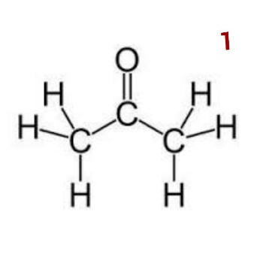
So, terpenes are classified according to the no. of such units present in the molecules.
1- Hemiterpenes (C=5)
a) Iso-Amyl alcohol
e.g Mentha species

Slide 26
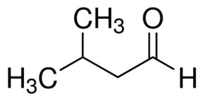
b) Iso-Valer Aldehyde
e.g Eucalyptus Oil

Slide 27
2. Monoterpenes/ Monoterpenoids (C=10)
They are also known as True Terpenes. They are classified as:
Acyclic/ Open Chain Compound
Monocyclic Terpenes
Dicyclic Monoterpenes
Tricyclic Monoterpenes

Slide 28
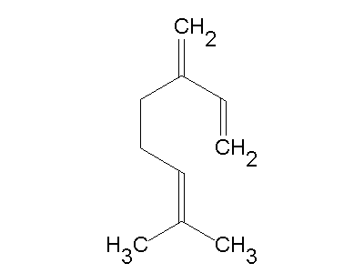
a) Cyclic/ Open Chain Compound
e.g Myrcene are found in Rhus species and have structure:
b) Monocyclic Hydrocarbon Compound/ Monocyclic Terpenes
e.g Mentha found in Mentha species and Limonene present in Citrus species.

Slide 29
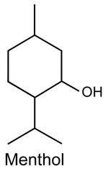

Slide 30
c) Dicyclic Monoterpenes
There are about seven types of dicyclic monoterpenes which are classified according to their ring structure. The most important are as follow:
Examples are
Thujone found in Thuja species
Carvene found in Caraway
Alpha & Beta pinene found in pine species
Borneal found in Camphor.

Slide 31
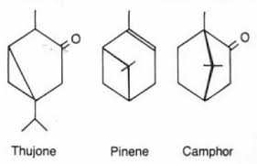

Slide 32
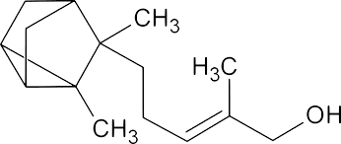
d) Tricyclic Monoterpenes
e.g Terasantalol from Santalum species

Slide 33
3. Sesquiterpenes compounds (C=15)
a) Open Chain/ Acyclic
Farnesol, which is widely distributed in plants and have
structure:

Slide 34
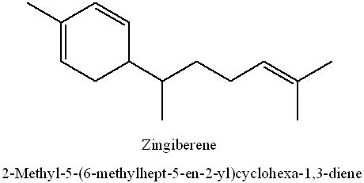
b) Monocyclic sesquiterpenes
e.g Zingiberene found in Ginger.

Slide 35
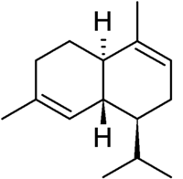
c) Dicyclic sesquiterpenes
Alpha Cadenine found in Cedrus species

Slide 36
4. Diterpenes/Diterpenoid Compounds (C=20)
They are mainly resinous substances found in plants
e.g Abietic acid.
Similarly, Gibberellic acid which are diterpenoids are found in higher plants have a marked effect on growth of seedlings.
Vitamin A is another diterpenoid which is found in some plants under carotenes i.e Alpha Carotenes and Beta Carotenes.

Slide 37
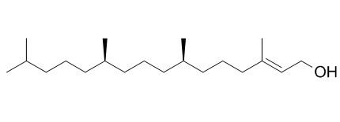
a) Acyclic
Phytol found with the chlorophyll.

Slide 38
b) Monocyclic diterpenes
Alpha Camphorene found in Cinnamum camphora.

Slide 39
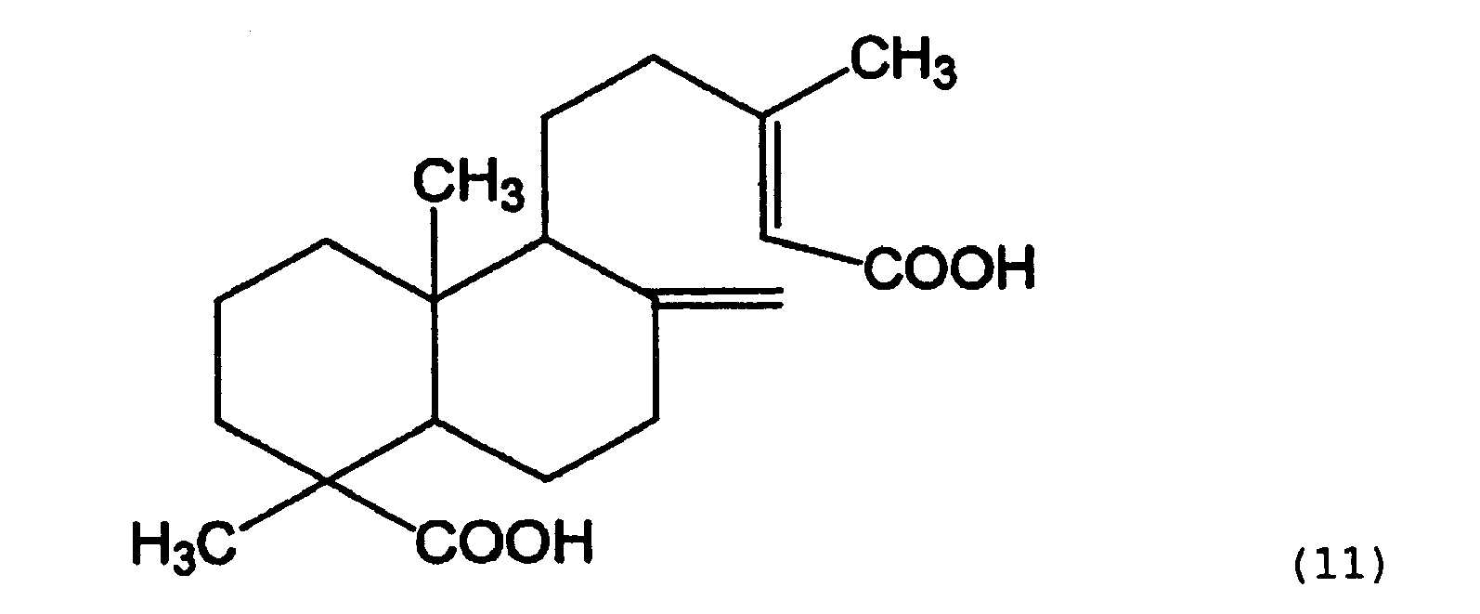
c) Dicyclic diterpenes
Agathic Acid found in Agathis alba.

Slide 40
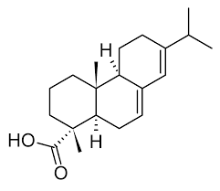
d) Tricyclic diterpenes
Abietic Acid found in Pinus species.

Slide 41
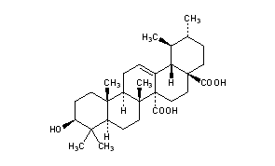
5.Triterpenes/Triterpenoid Compounds (C=30)
These are mainly found in plants in resins in the form of esters e.g Quinovic Acid found in Cinchona.

Slide 42
a) Acyclic Triterpenes
e.g squalene

Slide 43
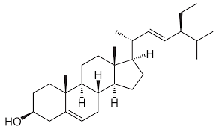
b) Tetracyclic Terpenoid Compounds
e.g Stigmasterol

Slide 44
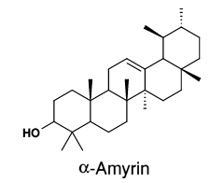
c) Pentacyclic Terpenes
e.g Alpha amyrin

Slide 45
6. Tetraterpenoid Compounds (C=40)
They are carotenoid pigment and the most important pigments are yellow and orange red. They are found along with the chlorophyll in the photosynthetic tissue.
The red color of tomato and the color of orange are due to lycopene. Greater variation in structure is noted in the fruits and in the petals.

Slide 46
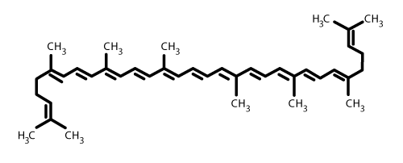
a) Acyclic tetraterpenoid
e.g Lycopene

Slide 47
b) Monocyclic tetraterpenoid
e.g ꙋ- carotene

Slide 48
c) Dicyclic tetraterpenoid
e.g β carotene

Slide 49
Polyterpenoid compounds
The poly-terpenoids are the compounds of many Isoprene units.
Example: Rubber
It is a polyterpenoid compound produced in the latex of about 300 genera of angiosperms.
Only HEVEA GENUS produce rubber on commercial scale in Malaysia and Indonesia.
Rubber from Hevea brasiliensis is a polymer containing 300-600 isoprene.

Slide 50
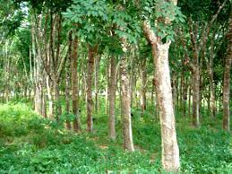
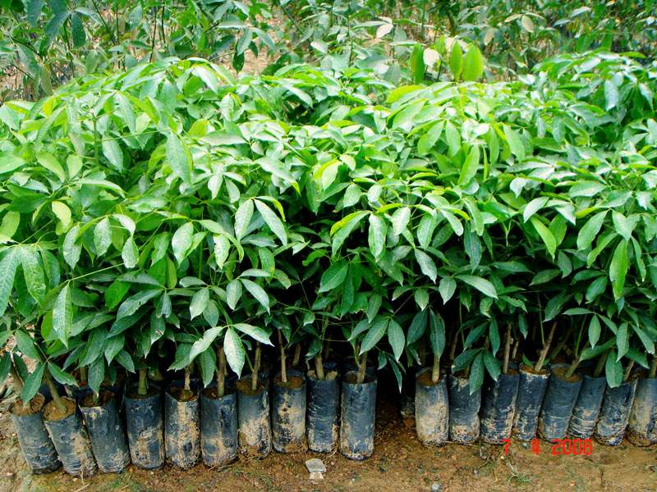

Slide 52
Mixed terpenoid compound
These are the compounds which consists of terpenoid component and a non-terpenoid component other than a sugar or fatty acids i.e terpenoid glycosides or esters.
For example:
Pyrethrin (insecticide) in Chrysanthemum spp.
Cannabidiol in cannabis sativa

Slide 53
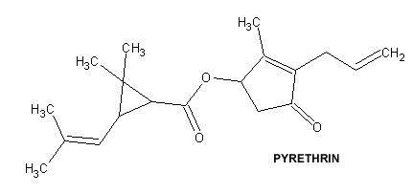
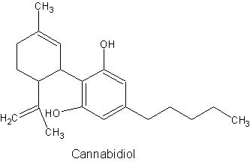

Slide 54
b. Stearoptene
In some oils, the hydrocarbon liquid portion dominate and only limited amount of oxygenated hydrocarbon portion are present.
Example: clove oil

Slide 55
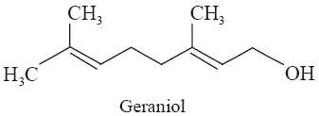
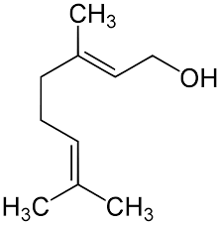
a) Acyclic stearoptene
e.g Geraniol etc

Slide 56
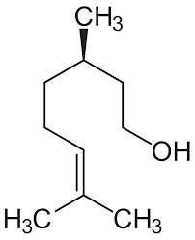
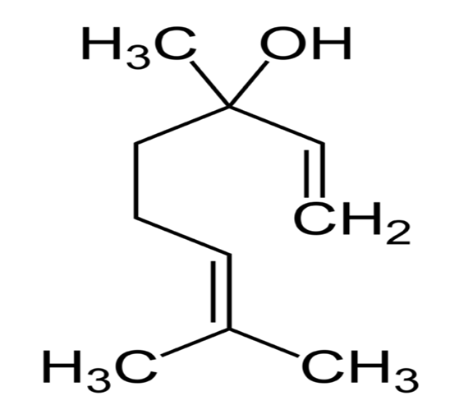
Citronellol Linalool

Slide 57
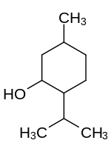
b) Monocyclic
e.g Menthol

Slide 58
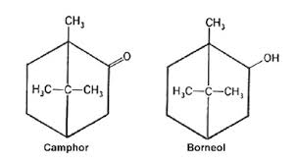
c) Dicyclic
e.g borneol, Ketone camphor

Slide 59
Classification of Volatile oils
There is no exact rule for the classification of volatile oils because so many active constituents are present in the same plant which have diverse action.
The type of constituents are so diverse and so numerous, the assignment of the oil and oil bearing drugs to a definite place in such classification is often difficult.

Slide 60
1. Hydrocarbon volatile oil
Cubeb
Terpentine
2. Alcoholic volatile oils
Peppermint
Cardamom
Coriander
3. Aldehydic volatile oils
Lemon peel
Bitter orange peel
Sweet orange peel
Cinnamon
Bitter almond oil

Slide 61
4. Ketonic volatile oils
Camphor
Spearmint
Buchu
Caraway
5. Phenolic volatile oils
Thyme
Clove
6. Phenolic ether volatile oils
Fennel
Anise
Myristica (Nut meg)

Slide 62
7. Oxide volatile oils
Chenopodium
Eucalyptus
8. Ester volatile oils
Rosemarry
9. Miscellaneous
Allium
Anethum

Slide 63
Hydrocarbon Volatile Oils

Slide 64
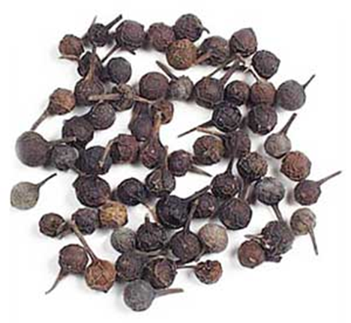
Cubeb (Tailed Pepper)
B.O: Piper cubeba
Family: Piperaceae
Part Used: Dried fully grown unripened fruit

Slide 65
Chemical constituents:
It yield 10-18% of volatile oil containing
i) Terpenes
ii) Sesque terpenes
iii) Resins
iv) Cubebic acid
v) Crystalline Cubebin

Slide 66
Uses
a) Diuretic
b) Expectorant
c) Urinary antiseptic
d) Remedy for gonorrhea
e) In Leucorrhea, piles and chronic bronchitis.

Slide 67
Turpentine
B.O:
Pinus plustrus
Pinus longifolia
Family: Pinaceae
Part Used: Oleo resins obtained from plant after incision.
Synonym: rectified oil of turpentine

Slide 68
Production and commerce
Pinus Oleoresion is a normal physiological product, it is secreted in plant tissues in special cavities as resin ducts.
These ducts are frequently located directly beneath the cambium. The resin ducts secrete the resin into the cavities.
These cavities are themselves formed either in a Schizogenous or Lysogenous manner.
They are anastomosing in nature when one of the passage is open, as in wound, the resin flows to the wound from distance.

Slide 69
Two methods of collection have been used for the collection of crude resin.
1. Box Method:
This is very old method previously used in USA. A large box was cut in the trunk ( main stem) and a blaze cut (groove) over it. The oleo resin which was collected in the box was removed at intervals and sent in barrels to the distillery. The trees were tapped to death in about 5-10 years. This method was wasteful causing destruction of vast area.

Slide 70
2. Cup and Gutter Method:
This method with different modifications are used. A series of V-shaped incisions are made on the trunk, the bark and young woods be removed so that the groove is formed in the trunk. All the base of the inscision and aluminium or earth ware cup is fixed to the trunk so that the resin flow into the cup. The cups are moved up higher in the tree and new grooves can be formed when the older become exhausted. As the cups become filled, their contents are emptied into barrels which are delivered to a distillery where turpentine oil is removed by steam distillation and the residue left after distillation of turpentine oil is known as Rosin/ Colophony.

Slide 71
Chemical Constituents:
Oils of turpentine chiefly contain
i) Bornylacetate
ii) Monoterpenes such as
α-pinine
β-pinene or camphene.

Slide 72
Uses:
a) A counter irritant
b) Rubeficient in the form of lotions
c) Mild antiseptic
d) It is now given internally.
e) It is also used in industry as solvent for waxes in
the production of synthetic camphor, in shoe polish
and in furniture polish.

Slide 73
Alcoholic Volatile Oil

Slide 74
Peppermint
Botanical Origin:
Mentha piperita
Family:
Labiatae
Part Used:
Dried leaves and flowering tops
Synonym:
Brandy Mint

Slide 75
Chemical Constituents:
About 1% of volatile oil containing
78% of free menthol,
20% of menthol is combined as esters, resins, tannins, acetic acid etc.

Slide 76
Uses:
i) It is mainly used as carminative, flavoring agent and stimulant.
ii) It is valuable in certain forms of dyspepsia, flatulence, cholic.
iii) Peppermint water, peppermint spirit are official preparations of British Pharmacopeaea.
iv) Oil of peppermint is powerful antiseptic and have local anesthetic action. These two properties make it valuable in the relief off both ache and in the treatment of cavities of teeth.

Slide 77
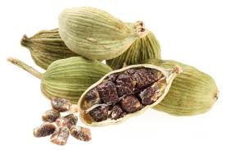
Cardamon
Botanical Origin:
Elettaria cardamomum
Family:
Zingeberaceae
Part Used:
Dried seeds

Slide 78
Chemical Constituents:
3-7% of volatile oil contains
Terpeneol
Bornyl acetate
It also contain proteins, calcium oxalate, fixed oils and small amount of carbohydrates.
Uses:
It is used as a carminative, stimulant and flavoring agent.
It is also used as a condiment.

Slide 79
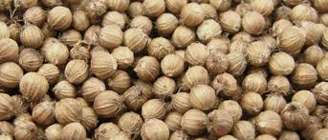
Coriander
Botanical Origin:
Coriandrum sativum
Family:
Umbelliferae
Part Used:
Dried ripened fruit

Slide 80
Chemical Constituents:
Contain 1% volatile oil containing:
Coriandrol (Linalool)
α-pinene
Fixed oils, calcium oxalate crystals.
Uses:
i) Carminative
ii) Stimulant
iii) Flavoring agent in confectionary and tobacco products.
iv) Condiment in bread, cake, pastries.

Slide 81
Aldehyde Volatile Oil

Slide 82
Bitter Orange Peel
Botanical Origin:
Citrus aurantium
Family:
Rutaceae
Part Used:
Dried rind of un ripened fruit.

Slide 83
Chemical Constituents:
1.Bitter orange peel contains of 1 to 2.5% volatile oil.
2. The principle component is
90% limonene, citronellal,
bitter amorphous glycoside like aurantiamarin and it’s acid; hesperidin, isohesperidin, vitamin C, and Pectin.
Uses:
i) Flavoring agent
ii) Carminative
iii) Aromatic agent

Slide 84
Sweet Orange Peel
Botanical Origin:
Citrus sinensis
Family:
Rutaceae
Part Used:
Dried rind of ripened fruit

Slide 85
Chemical Constituents:
Volatile oil containing
Limonene
Linalool
Glycoside hesperidin
Uses:
The peel of sweet orange is used to
Increase appetite
Reduce phlegm
Treat coughs.

Slide 86
Lemon Peel
Botanical Origin:
Citrus limon
Family:
Rutaceae
Part Used:
Fresh yellow outer rind of ripened fruit

Slide 87
Chemical Constituents:
Lemon peel contains volatile oil (2.5%), vitamin C, hesperidin, mucilage, pectin and calcium oxalate.
The important constituents of the volatile oil are limonene (90%), citronellal, α-pinene, camphene, linalool, β-pinene, and geranial.
The peels also contain flavonoids epigenin, luteolin, quercetin, hesperidin and β-coumaric acid.

Slide 88
Uses:
It is used as a flavoring agent.
Lemon peel is used as a flavoring agent, perfumery, stomachic, and carminative.
The oil, externally, is a strong rubefacient and if taken internally in small doses has stimulating and carminative properties.

Slide 89
Cinnamon
Botanical Origin:
Cinnamomum zeylanicum
Family:
Lauraceae
Part Used:
Dried inner bark

Slide 90
Chemical Constituents:
Volatile oil containing
Pinene
Cinnamic aldehyde
Benzaldehyde
Small amount of resins, starch, tannins, and calcium oxalate.
Uses:
Aromatic agent
Favoring agent
Carminative

Slide 91
Ketonic Volatile Oil

Slide 92
Caraway
B.O:
Carum carvi Family:
Umbelliferae
Part Used:
Dried ripened fruits

Slide 93
Chemical Constituents:
It has 4–7% volatile oil which consists of about 60% carvone, dihydrocarvone, carvacrol, and terpene limonene. The chief constituent of the oil is a hydrocarbon termed carvene and an oxygenated oil carvol.
Uses:
Flavouring agent
Carminative
Condiment
It is recommended in dyspepsia, for flatulent indigestion.

Slide 94
Bachu
B.O:
Barosma betulina
Family:
Rutaceae
Part Used:
Dried leaves

Slide 95
Chemical Constituents:
a)Volatile oil with a peppermint like smell containing: 1) Diosophenol
2) L-menthol 3) Menthone b) It also contain crystalline glycoside hesperidine.
Uses:
1. Disinfectant to the urinary tract, prostatitis(inflammation
of prostate gland). 2. Diuretic 3. Antiseptic

Slide 96
Camphor
B.O:
Cinnamomum camphora
Family:
Lauraceae
Part Used:
Wood or young twigs are used for distillation of camphor or can be synthetically prepared.

Slide 97
Production/Preparation of camphor:
a) The best yield of camphor is obtained from trees of 50 years old plant. The young twigs and branches are chopped and placed in a wooden still.
b)The wooden still is heated by adding boiling water in a wooden pan which is placed in a wooden still.
c) The end of the still is connected with a bamboo tube which open into tubes which are also made up of wood.
d) The one tube is placed over the other. The water accumulate in the lower tube and the sublimation of the camphor deposits on the lower surface of upper tube.

Slide 98
e) After full circulation, the sublimation is removed, it requires about 11-12 hours to distill one complete still of camphor.
f) 40-50 pounds of chips are required to get 1 pound of crude camphor.
Synthetic preparation of camphor: Camphor can also be prepared synthetically from turpentine.

Slide 99
Chemical Constituents
Camphor oil contains
Camphor
Cineole
Pinene
Camphene
limonene and diterpenes.

Slide 100
Uses
Camphor is used externally as a rubefacient, counterirritant
and internally as a carminative and antiseptic.
It is anti-infective, used as 1–3% in skin medicaments and in cosmetic.
It is also used to manufacture some plastics, in lacquers, varnishes, explosives, as moth repellent

Slide 101
Spearmint (Pudina)
B.O:
Mentha spicata
Family:
Labiatae
Part used:
Dried leaves and flowering tops

Slide 102
Chemical constituents
It contains about 0.5% volatile oil containing carvone.
It also contains limonene, dihydrocarveol acetate, esters of acetic, butyric acids.
The drug also contains resin and tannins.

Slide 103
Uses
The drug is used as spice, flavouring agent,carminative,
digestive, spasmolytic, stimulant, and as a diuretic.
Pudina is chiefly used for culinary purposes.
Sweetened infusion is an excellent remedy for infantile trouble and also a pleasant beverage in fevers, inflammatory diseases, etc.

Slide 104
Phenolic Volatile Oil

Slide 105
Clove
B.O:
Eugenia cryophyllus
Family:
Myrtaceae
Part Used:
Dried flowering buds

Slide 106
Chemical Constituents:
Volatile oil containing
Phenol
Eugenol,
Iso eugenol,
B-cryophyllene
Vanillin.

Slide 107
Uses:
Clove is used as an aromatic, carminative, and condiment.
It is also used in flatulence, dyspepsia, emesis etc.
The oil of clove is a local irritant, strong germicidal
and powerful antiseptic.
It is also used as local anaesthetic applied to decayed teeth & has been used with success as expectorant in bronchial troubles.

Slide 108
Thyme
Botanical Origin:
Thymus vulgaris
Family:
Labiatea
Part Used:
Dried flowering tops or leaves

Slide 109
Chemical constituents:
a) Volatile oil containing
Thymol
thymine
pinene
b)Tannins etc.

Slide 110
Uses:
It is used as
Antispasmodic
Carminative
Stimulant
Condiment in the flavoring of meat & fish dishes.

Slide 111
Phenolic Ether Volatile Oil

Slide 112
Anise
B.O:
Pimpinella anisum
Family:
Umbelliferae
Part Used:
Dried fruit

Slide 113
Chemical Constituents:
Volatile oil containing Anethol. It also contains
Tannins
Fixed oils
Proteins
Calcium oxalate

Slide 114
Uses:
It is used as:
a) Stimulant
b) Carminative
c) Flavoring agent
d) Condiment

Slide 115
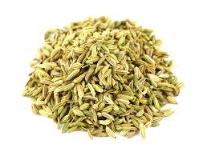
Fennel
B.O:
Foeniculum vulgare
Family:
Umbelliferae
Part Used:
Dried ripened fruit

Slide 116
Chemical Constituents:
The best varieties of Fennel contain 4 to 5% of volatile oil.
The primary constituents of volatile oil are 50 to 60% of anethole (phenolic ester) and 18 to 22% of fenchone
(ketone). Fenchone is chemically a bicyclic monoterpene.
The oil of Fennel has β-pinene, anisic acid and anisic aldehyde. Fennel also contains about 20% fixed oil and 20% proteins.

Slide 117
Fenchone

Slide 118
Uses
1. Fennel is used as stomachic, aromatic, diuretic, carminative and flavoring agent.
2. Anethole may have estrogen-like activity and inhibit spasms in smooth muscles.
3. Fennel
can increase production of bile,
used in the treatment of infant colic,
to promote menstruation in women,
can increase lactation,
act as antipyretic, antimicrobial and antiinflammatory.

Slide 119
Myristica
B.O:
Myristica fragrans
Family:
Myristicaceae
Part Used:
Dried ripened seeds

Slide 120
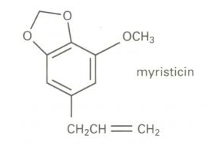
Chemical Constituents:
Nutmeg contains of 5 to 15% volatile oil, lignin, starch, gum, coloring matter.
The volatile oil contains myristicin, geraniol, borneol,
pinene, camphene, and dipentene.

Slide 121
Uses
Myristica is aromatic, carminative, flavoring agent.
It has narcotic action and peripherally it irritates and produces anesthetics action, since it irritates intestine and uterus it can cause abortion.
Oil of Nutmeg is used to conceal the taste of various drugs and as a local stimulant to the gastrointestinal tract.

Slide 122
Oxide Volatile oil

Slide 123
Eucalyptus
B.O:
Eucalyptus globulus
Family:
Myrtaceae
Part Used:
Dried leaves

Slide 124
Chemical constituents:
Eucalyptus oil contains volatile oil of which 70 to 85% is 1,8-cineole also known as eucalyptol.
The other constituents present are p-cymene, α-pinene; small quantity of sesquiterpenes like ledol; aldehydes,
ketones, and alcohols.
It also has polyphenolic acids like ferulic acid, caffeic acid, gallic acid; flavonoids such as eucalyptin, and rutin.

Slide 125
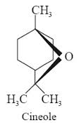

Slide 126
Uses:
The oil is used as stimulant, antiseptic, flavoring agent, aromatic, deodorant, expectorant, antimicrobial, diuretic, and antispasmodic.
It is also used in the treatment of lung diseases, sore throat, cold, as a vapor bath for asthma and various respiratory ailments and in bronchitis.

Slide 127
Chenopodium
B.O:
Chenopodium ambrosioides
Family:
Chenopodiaceae
Part used:
Fresh aerial parts

Slide 128
Chemical constituents:
Ascaridole, a terpene peroxide, to the high percentage of 60 to 70%, an unstable substance is present in the oil.
It also contains p-cymene, α-pinene.
Choline, glycol, and safrol have also been reported.

Slide 129
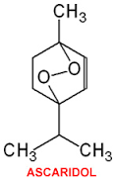

Slide 130
Uses:
Chenopodium oil is used as anthelmintic especially in
tapeworm, round worms, and hook worms.
It is also used as active purgative, in the treatment of malaria and other nervous diseases.
It is employed in veterinary practice in a worm mixture for dogs, in combination with oil of turpentine, oil of aniseed, castor oil, and olive oil.

Slide 131
Ester volatile oil

Slide 132
Rosemary
B.O:
Rosmarinus officinalis
Family:
Lamiaceae
Part used:
Flowering tops of leafy twigs

Slide 133
Chemical Constituents:
The fresh material yields about 1–2% of volatile oil containing 0.8–6% of esters, and 8–20% of alcohols.
The principal constituents are 1,8-cineole, borneol, camphor, bornyl acetate, and monoterpene hydrocarbons.
Rosemary leaves also contain the triterpene alcohols α- and β-amyrins, rosmarinic acid, glycosides of luteolin.

Slide 134
Uses:
The oil is mainly used in the perfumery industry.
It is a component of soap liniment and is frequently used in
aromatherapy.
The oil is also used for gastrointestinal disturbances,
to enhance urinary and digestive elimination.
Topically, it is applied to clear nasal passages, for colds, as a mouthwash and for rheumatic ailments.
Rosemary extracts are used in food technology as antioxidants and preservatives.
Cornosolic acid, a diterpene isolated from R. officinalis,
shows a strong inhibition of HIV-1-protease activity. It
shows cytotoxicity at the dose which is close to effective
antiviral dose.

Slide 135
Miscellaneous

Slide 136
Allium (Garlic)
B.O:
Allium sativum
Family:
Liliaceae
Part Used:
Dried inner fleshy scales of bulb

Slide 137
Chemical constituents:
Allicin, a yellow liquid responsible for the odor of garlic, is the active principle of the drug.
The other constituents reported in Garlic are alliin.
Upon cleavage by the specific enzyme alliinase, an odor of garlic develops, and the fission products show antibacterial action similar to allicin.
The amino acids present in the bulb are leucine, methionine.

Slide 139
Uses:
Garlic is carminative, aphrodisiac, expectorant, stimulant, and used in fevers, coughs, respiratory diseases such as chronic bronchitis, bronchial asthma, whooping cough, and tuberculosis.
It is also used in hypertension.
The garlic can cause gastrointestinal distress and alters breath and skin odor.
Garlic or its constituents exhibit various biological activities, such as antibacterial, antifungal, antiviral, antitumor, and anti-diabetic effects.

Slide 140
Anethum (Dill)
B.O:
Anethum graveolens
Family:
Apiaceae
Part Used:
Dried ripened seeds

Slide 141
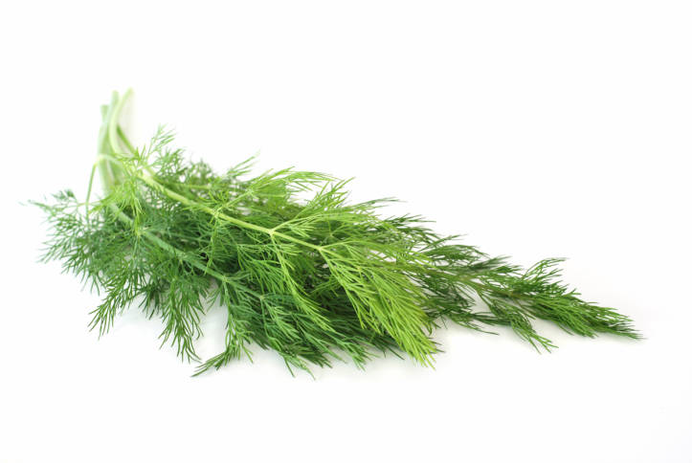
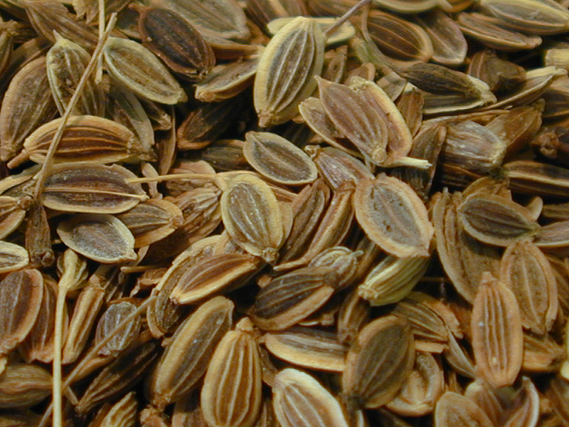

Slide 142
Chemical Constituents:
It contains :Volatile oils resembles with that of oil of Caraway and fennel containing:
Cavone
Fenchone
Limonene

Slide 143
Uses:
It is used as
Carminative agent
Flavoring agent
It is used in infants gripe water.
Diarrhea and Dysentery: The carminative oil of Anethum is a powerful remedy for diarrhea.

Slide 144
Thank You

